Slide 1
DATT ASSESSMENT II
Tenzin rabyang – 30017118
Sheffield Hallam university
01-12-2021

Slide 2
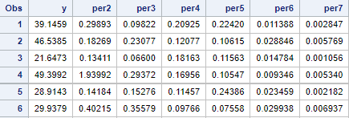
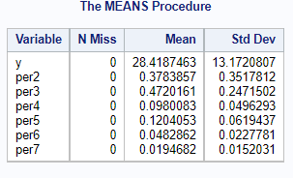
1a) Adding variables Y and Per2 to Per7 to the data set.
Undertake a brief exploratory analysis of the variables Y, A1 and Per2 to Per7 by obtaining the sample mean and sample standard deviation for each of these variables
Y: The mean of total cost per active member is at 28.4 pound where average spread of data is 13.17
per2: The mean of number of deferred pensioners per active member is 0.378 while average spread of data is 0.3517
per3: The average value of pensioners per active member is 0.472 where spread of data is at 0.247
per4: Starter in current year per active member has average value of 0.098 with standard deviation of 0.0496
per5: Number of leaver has average of 0.120 with 0.0619 spread.
per6: Number of new pensioner in current year has average of 0.0482 with 0.0227 data spread.
per7: Number of cessation in current year has average value of 0.0194 with 0.0152 data spread.
NO MISSING VALUE.

Slide 3

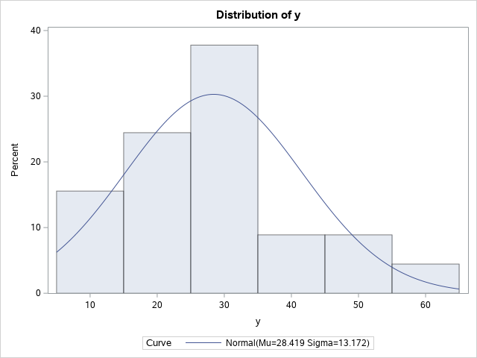
histogram for the response Total cost(y)
It’s Uni-model
Symmetric/normal distribution
Bell like shape
Mean range 25-35
Little positive skewed

Slide 4
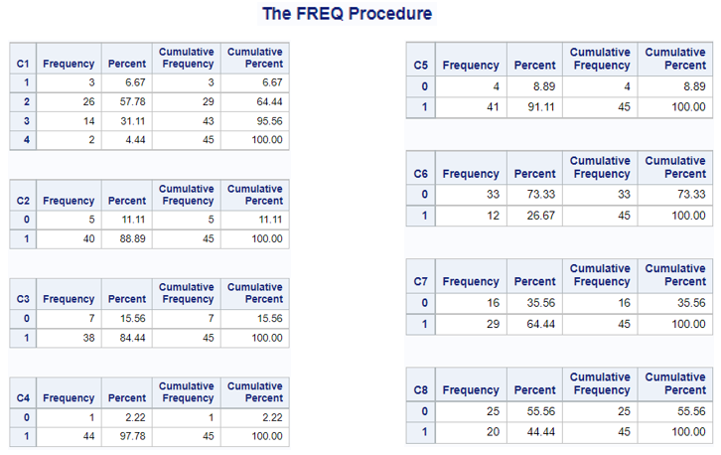
1b)Investigate each of the factors C1 to C8 by obtaining a simple frequency distribution
C1: Fund type combine scheme of same scales has highest active member with 57.78% while fund type combine scheme of different scales has the lowest with only 4.44%.
C2: 88.89% of scheme is contracted out.
C3: 84.44% of scheme is contributory
C4: 97.78% of member can pay AVC’s
C5: 91.11% of admin base is in one location
C6: 73.33% of admin calculation are not done in IT platform
C7: 64.44% of special communication are sent to member at year end, while 35.56% aren’t.
C8: 55.56% are not communicate directly to member when rule changes but 44.44% are communicate directly.
Since, we only have one frequency for member who can’t pay the
AVC (additional voluntary contributions), which means that frequency of
“0” in C4 is only 1.
Also AVC is done voluntarily, hence the data won’t be consistent with
time.

Slide 5
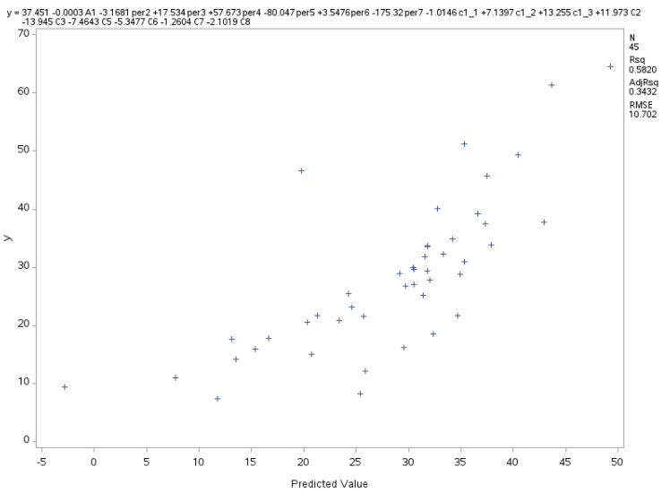
2. Fit of the systematic component of the model
Scatter plot between the response variable “y” and its predicted value.
Intercept value is 37.451 and parameter value of all other exploratory variable is non-zero.
Based on the diagram, I can assume that intercept value is non-zero which reject the null hypotheses which states that intercept value is zero.
Hence the fit of the SYSTEMATIC COMPONENT IS VALID.

Slide 6
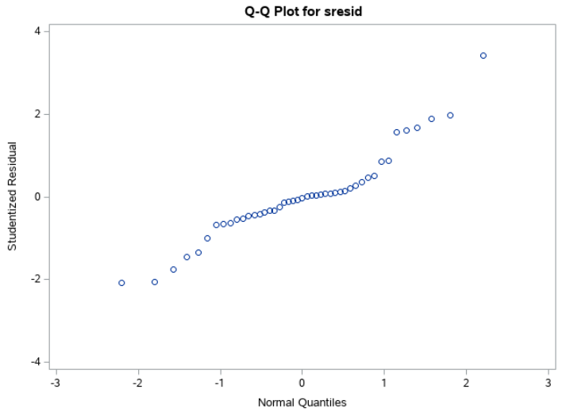
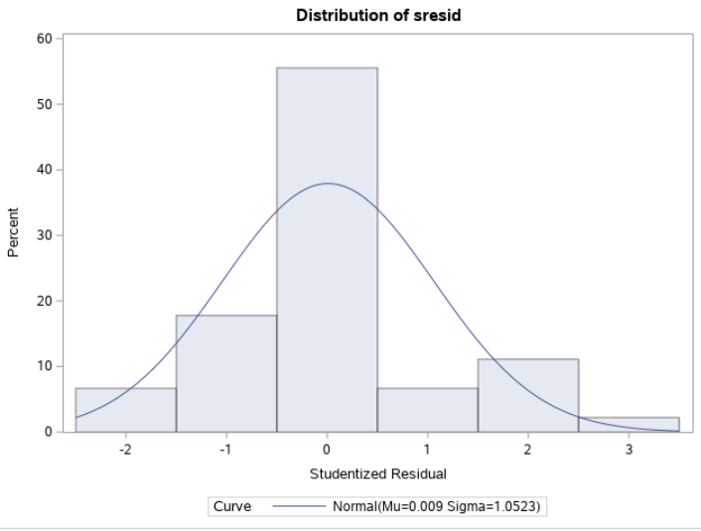
Investigate the tenability of the appropriate underlying statistical assumptions
1. Normality.
Uni-Model
Symmetric/ normal distribution
Mean at 0
Q-Q plot shows straight line of studentized residual
Hence the normality Assumption is ACCEPTED.

Slide 7
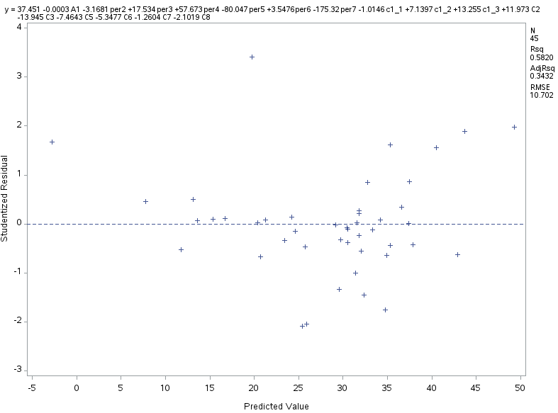
2. Homoscedasticity.
Not randomly scatter
Shows pattern
No constant variance
Not Accepted
3. Mutual Independence
Since the plots shows certain pattern, there might be relation between the exploratory variable.
Not ACCEPTED.

Slide 8
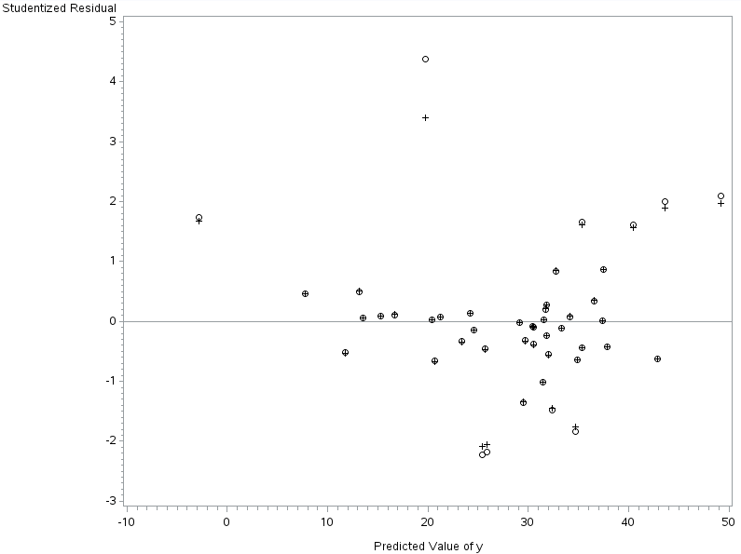

4. Adequacy of the Systematic Component.
Studentized and deleted residual are super impose with each other.
Few are not.
One residual goes beyond +4.
It has quite long separation.
Potential outlier
Plot shows pattern
No constant variance
Hence, Not Accepted.

Slide 9
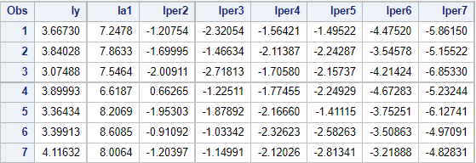
3a) Why not transform C1-C3 and C5-C8
IT is categorical data
It contains only either value 1 or zero
Log(0)= undefine/null
Log(1) = 0
Hence data will contain only “0” value.
Data will get inconsistent and disrupted.
3b)Add the variables LY = log(Y), LA1 = log(A1), LPer2 = log(Per2),...,LPer7 = log(Per7) to your data set.

Slide 10
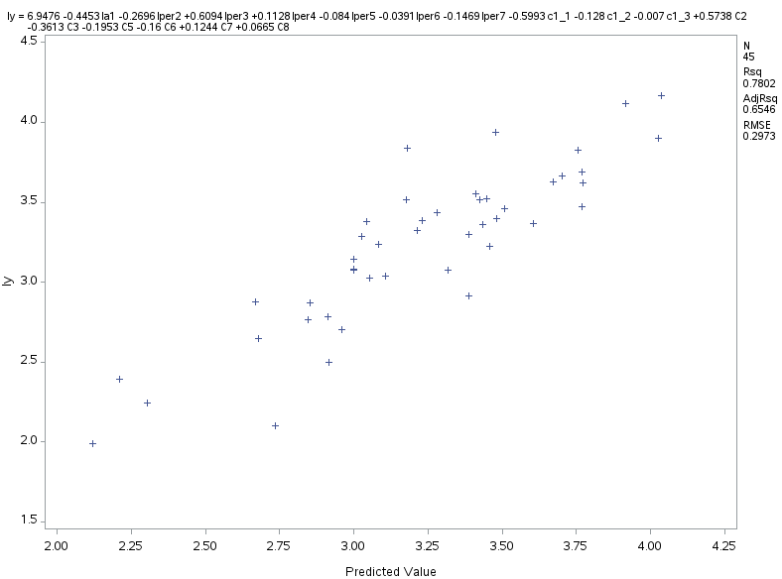
Investigate the fit of the systematic component of the model
Much better than earlier model.
Shows better linear/straight line
Intercept value of 6.94
Hence Reject Null Hypotheses
Fit of model is Valid

Slide 11
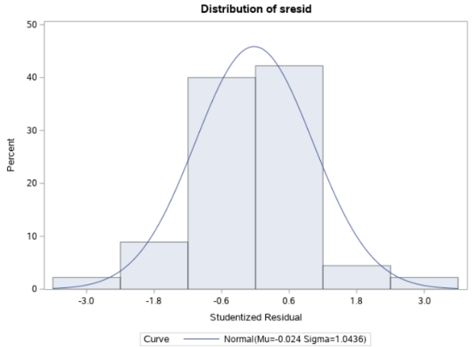

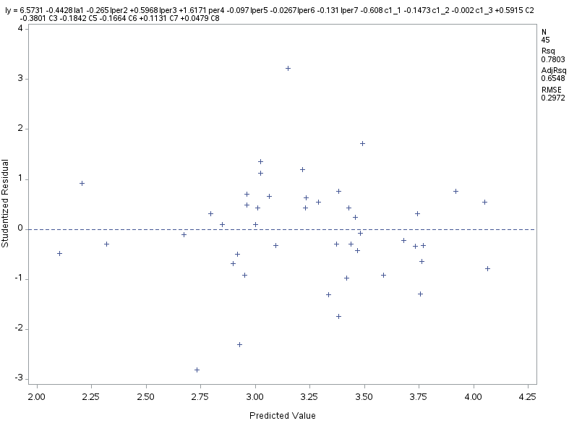
Normality
Its is Uni-model with Symmetric distribution
Mean around zero
Bell like shape
Can’t notice skewedness
Q-Q plot shows straight line
Accpeted
Homoscedasticity
Much better randomly scatter
No pattern detected
But less variance
Accepted

Slide 12
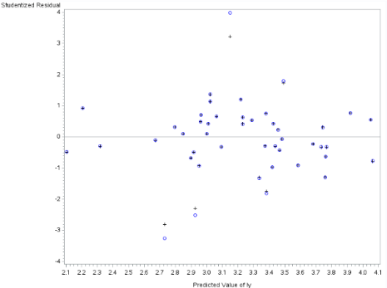
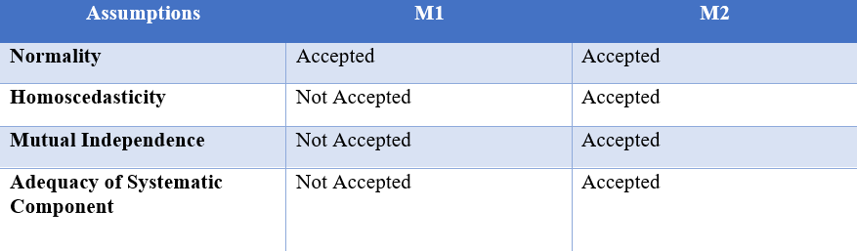
Mutual Independence
Since no pattern recognize, less likely to have mutual relation between the observation.
Hence, Accepted
Adequacy of Systematic Component
Almost perfectly super impose
Randomly scatter
Few potential outlier detected
Extreme value are within ±4.
Since no recognition of pattern, adequacy is accepted.

Slide 13
4a) identify an overall "best" model for the prediction of log(Y)
Number in Model | R² | MSE
1 | 0.5291 | 0.12328
2 | 0.5899 | 0.10995
3 | 0.6168 | 0.10523
4 | 0.6626 | 0.09497
5 | 0.6903 | 0.08942
6 | 0.7113 | 0.08553
7 | 0.7335 | 0.08109
8 | 0.7441 | 0.08003
9 | 0.7527 | 0.07956
10 | 0.7607 | 0.07926
11 | 0.7660 | 0.07983
12 | 0.7710 | 0.08055
13 | 0.7770 | 0.08098
14 | 0.7797 | 0.08267
15 | 0.7802 | 0.08533
16 | 0.7802 | 0.08838
Number in Model | R² | Adjusted R²
1 | 0.5291 | 0.5182
2 | 0.5899 | 0.5703
3 | 0.6168 | 0.5888
4 | 0.6626 | 0.6289
5 | 0.6903 | 0.6506
6 | 0.7113 | 0.6657
7 | 0.7335 | 0.6831
8 | 0.7441 | 0.6872
9 | 0.7527 | 0.6891
10 | 0.7607 | 0.6903
11 | 0.7660 | 0.6880
12 | 0.7710 | 0.6852
13 | 0.7770 | 0.6835
14 | 0.7797 | 0.6769
15 | 0.7802 | 0.6665
16 | 0.7802 | 0.6546
Number in Model | R² | Cp
1 | 0.5291 | 18.9851
2 | 0.5899 | 13.2510
3 | 0.6168 | 11.8176
4 | 0.6626 | 7.9841
5 | 0.6903 | 6.4591
6 | 0.7113 | 5.7772
7 | 0.7335 | 4.9480
8 | 0.7441 | 5.6013
9 | 0.7527 | 6.5093
10 | 0.7607 | 7.4912
11 | 0.7660 | 8.8096
12 | 0.7710 | 10.1679
13 | 0.7770 | 11.4059
14 | 0.7797 | 13.0634
15 | 0.7802 | 15.0004
16 | 0.7802 | 17.0000
Now it is impracticable to
consider all the model because,
Not all models are
significant.
Not all models accept the
assumptions of regression.
More model means more
computation power is required.
Not all models produce
accuracy results.
R-square and MSE
Adjusted R-square
Cp method
Table: 4.1
Table: 4.3

Slide 14
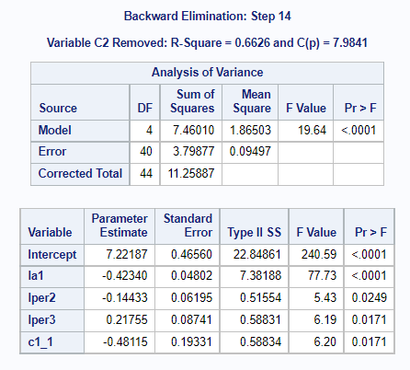
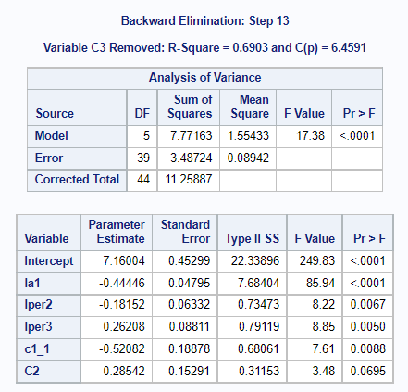
4b) Employ a backward elimination procedure, justifying your choice of final model.
Model | Step14 | Spte13
R-square | 0.6626 | 0.6903
MSE | 0.09497 | 0.0894
Cp | 7.9841 | 6.4591
R-square value not much high
High Cp value
High MSE value
High error sum of square (residual)
R-square value bit better
Low Cp value
Low MSE value
Lower error sum of square
Final “Best” Model

Slide 15
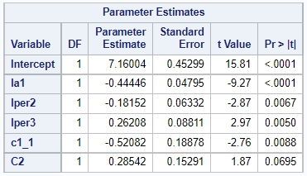
4b) Obtain, discuss, and interpret the parameter estimates for your final model.
-ve shows, negative relationship
Intercept value is 7.16004
Standard error shows spread of the mean and tell the accuracy.
t-value can tell the similarity between the target variable and independent variable.
More, t-value means more similarity or vice versa.
All are significant except for C2.

Slide 16
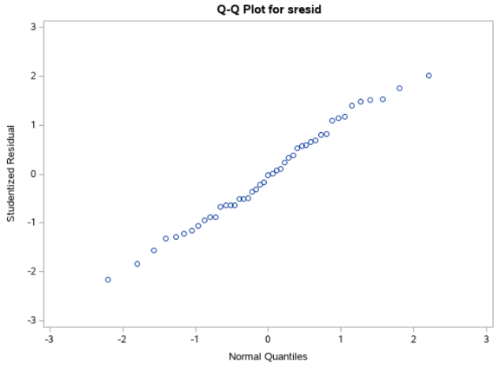
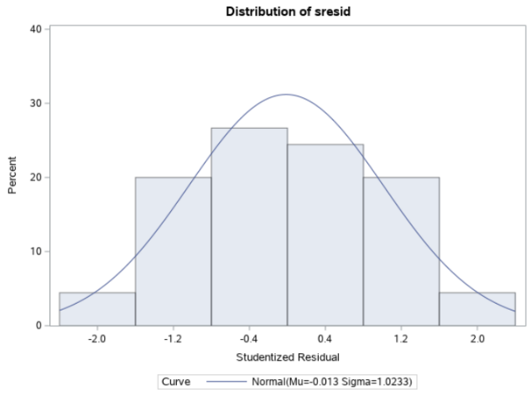
5) Use appropriate plots to investigate the fit of your final model.
Normality
Uni-model with symmetric distribution.
Mean at almost zero
Average data spread is 1.0233(sigma)
Bell like shape
No skewedness notice
Q-Q plot shows straight line passing through the origin.
Hence, accepted.

Slide 17
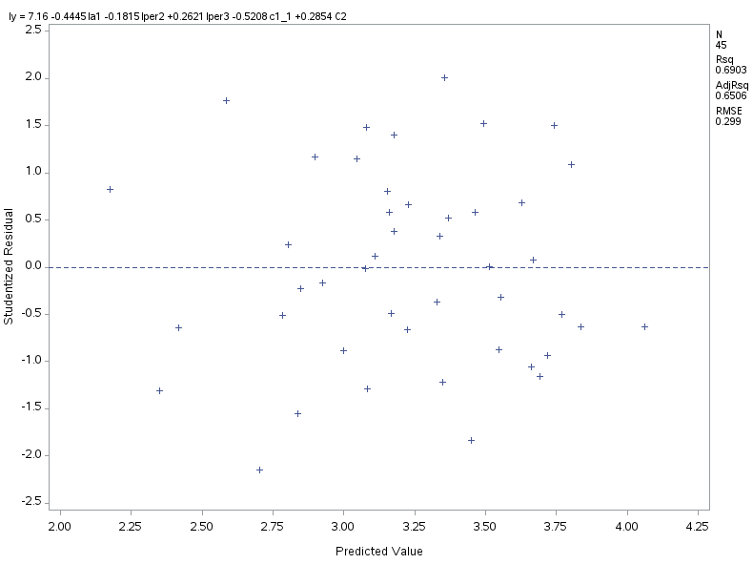
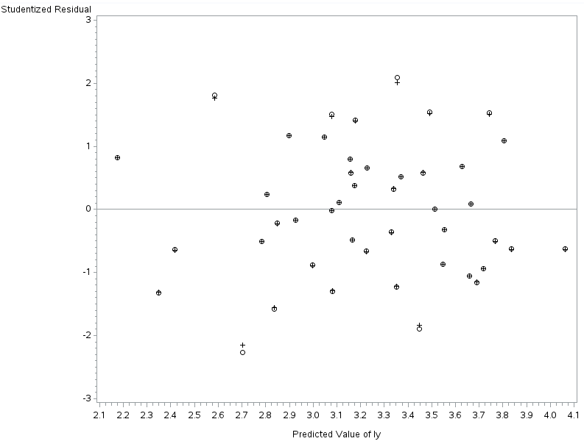
Homoscedasticity
Randomly scatter
Much better constant variance
No pattern detected
R-square – 0.6903, Adj R – 0.6506
RMSE- 0.299
Mutual Independence
Since no sign of pattern are recognize, its safe to say that to relationship are not present between the observation.
Adequacy of Systematic Component
Almost perfectly imposed
Few of them are not impose
Residual are well within ±3

Slide 18
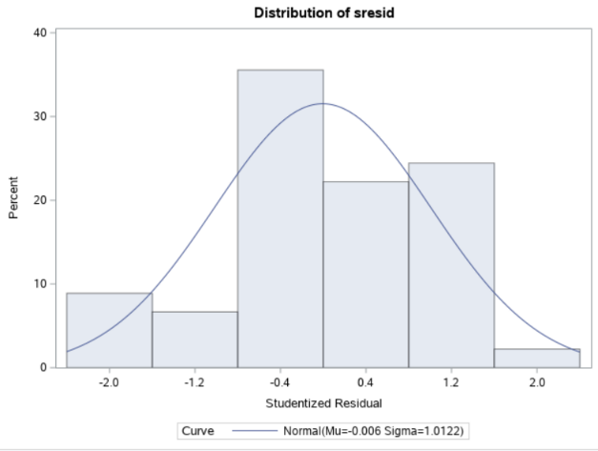
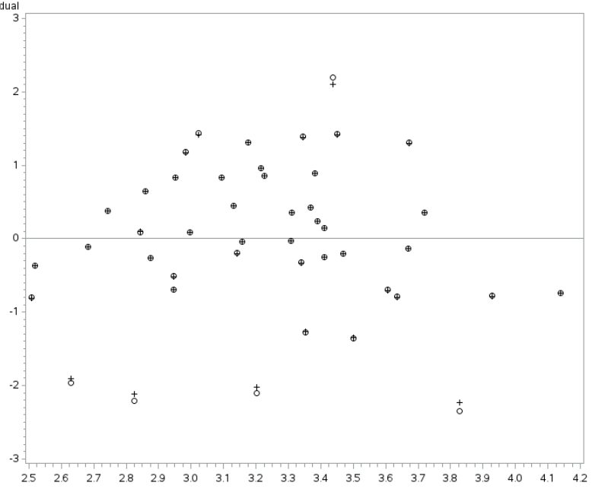
In addition to the overall fit, investigate the fit with respect to each of the explanatory variables
la1- First variable.
Uni-Model with normal distribution
Bell like shape
Mean at 0.006
Not skewedness notice
Random scatter
No pattern
Better constant variance
Few potential outlier

Slide 19
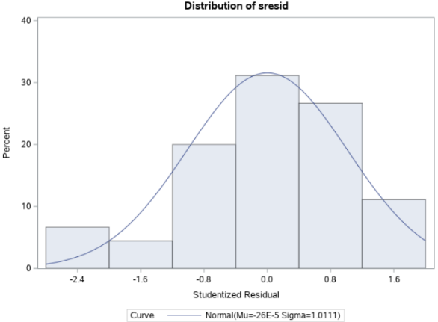
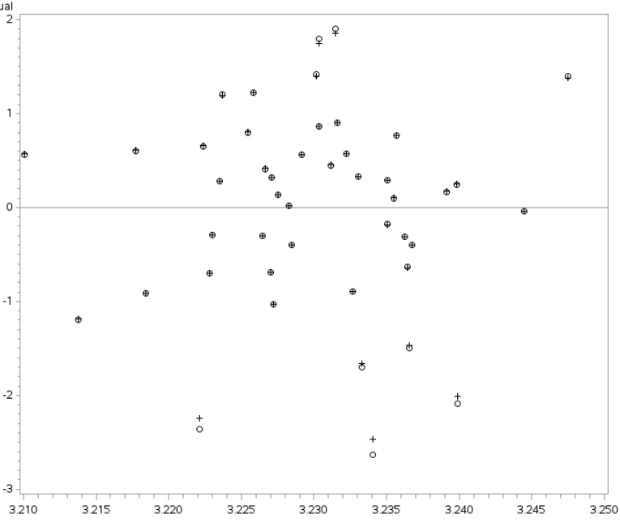
lper2 – Second Variable
Near normality distributed
Bell like structure
Little negative skewed
Uni-Model.
Random scatter
Not much variance
No pattern
Few potential outlier

Slide 20
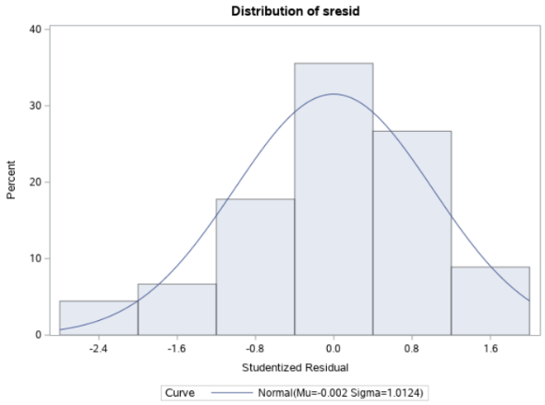
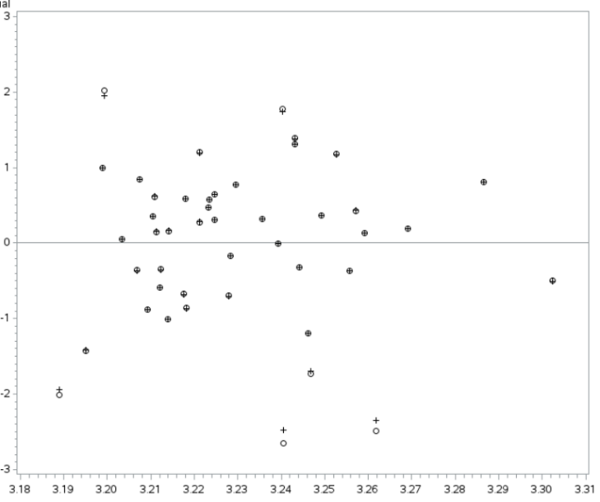
lper3 – Third variable
Near normality
Bit negative skewed
Uni-model
Shape like bell
Mean is near zero
Average data spread is 1.0124
Randomly scatter
No pattern
But less constant variance
Few potential outlier

Slide 21
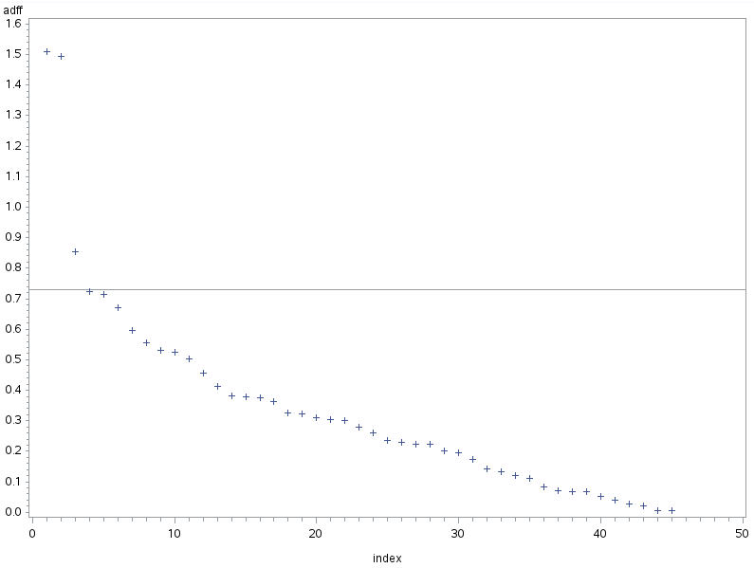
6a) Using your final model, investigate and briefly discuss any issues relating to outliers or influential points
Outlier
Based on scatter diagram, few potential outlier might present.
Influential points.
* Reference line(vref) is 0.730 (2*sqrt(p/n))
Three are observed
Lower one point can be ignore since it is near to vref
But Two points near 1.5 might be potential outlier
Not to be concern since all the points are less than 2.

Slide 22


DIFFITS
Dff in the table is Difference of fits.
Since both of observation has lower than ±2
So, should not be concern about.
Need more details
First observation has slightly higher deleted residual of 2.09
Cut-off value for H is 0.4 (3*(p/n))
Range of C is 1±3(p/n) = 0.6 to 1.4

Slide 23
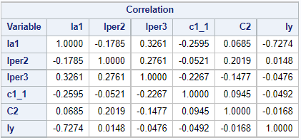
6b) Investigate and discuss any issues of multicollinearity in your final model.
Correlation
Not much of correlation is found
Maximum correlation has value of lper3 and la1 with 0.3261.
Since most of the value is very low, this means weak correlation.
Don’t use ly (target variable)

Slide 24
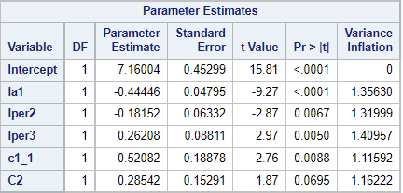
Variance Inflation Factors
Usually, VIF value of more than 10 is considered as high correlation.
But all of the variables has less than 2 VIF value.
This also shows weak correlation between exploratory variable.
However, we can still use advance method call condition indices.

Slide 25
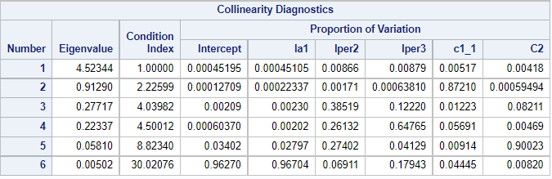
Condition Indices
Better method to find correlation
Two rule of thumb,
1. Condition index value is more roughly 3-4 times than preceding.
2. Should be more than 30.
6th observation checks both rule.
Now look for corresponding value of variables.
Only la1 has high value (OK)
No other variables has high value as la1.
Might have very little relation between lper3 and la1.(no concern)
It shows weak correlation.

Slide 26
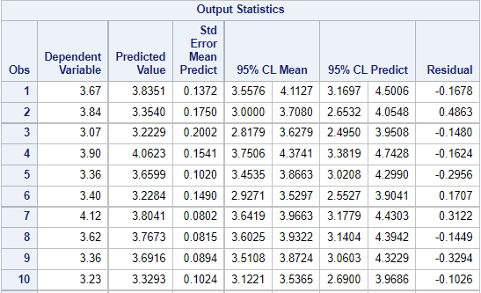
7) Determine the form of confidence interval that best serves this purpose - the confidence interval for the fitted mean, or the confidence interval for a predicted observation.
The range of confidence intervals of predict is more than that of mean.
It means that there is more confidence in predict than mean.
This is mainly because, confident interval of mean considered whole observation making it harder to make decision.
But in predict confident interval, it only takes individual corresponding value rather than whole observation.
Which make model more confident while making decision
Hence the pension fund manager should use prediction confident interval rather than mean confident interval

Slide 27
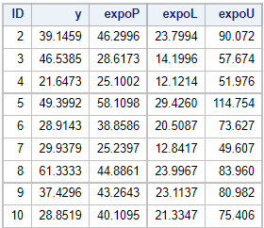
Obtain the relevant predictions and confidence intervals. Explain how a participating pension fund manager would use this information. Illustrate you answer by considering the results for two different schemes.
“y” is the actual total cost of active member and “expoP” is prediction from the model.
In observation 2, actual cost of a member is 39.1459 but model has predicted that total cost is 46.299. With 95% assurance, total cost would be in the range of 23.79 to 90.07.
Similarly in observation 3, actual cost of a member is 46.53, but model has predicted 28.6173. And with 95% confident, total cost would lies in between 14199 to 57.67.

Slide 28
THANK YOU

